Slide 1
Intro to Data Science
Karan Shukla

Slide 2
Downloads
RStudio
https://www.rstudio.com/
Slides, Data, and Code

Slide 3

About Me
B.S. in Computer Science, 2017
M.S. in Computer Science, 2018
internships at Verizon, IBM in data science, software engineering
joining Google after graduation

Slide 4
What is data science?
“Data science… is an interdisciplinary field about scientific methods, processes, and systems to extract knowledge or insights from data in various forms” - Wikipedia

Slide 5
What is data science?
Scientific Method
Hypothesize → Experiment → Publish Results → Repeat
Applied Statistics…
… using research techniques
… with the help of technology

Slide 6













Who needs data scientists?
Notes:
Basically any company that handles a lot of data

Slide 7
What do Data Scientists create?
Reporting / Visualization
Predictive models / Machine Learning
Decision making / Artificial Intelligence

Slide 8
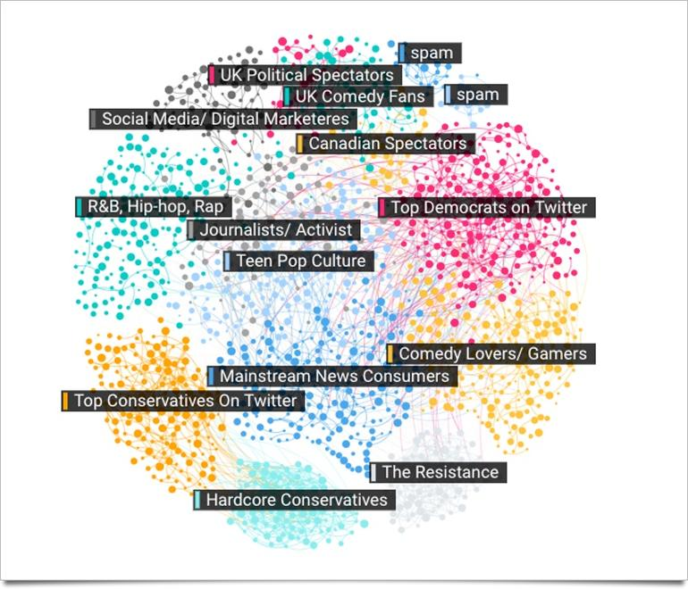
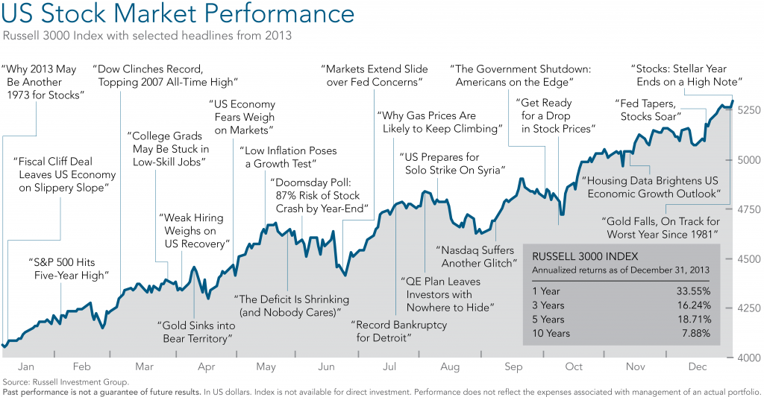
Reporting
Notes:
Maps, Time Series, Clustering
fun fact: spam was first popularized in the UK due to food shortages

Slide 9
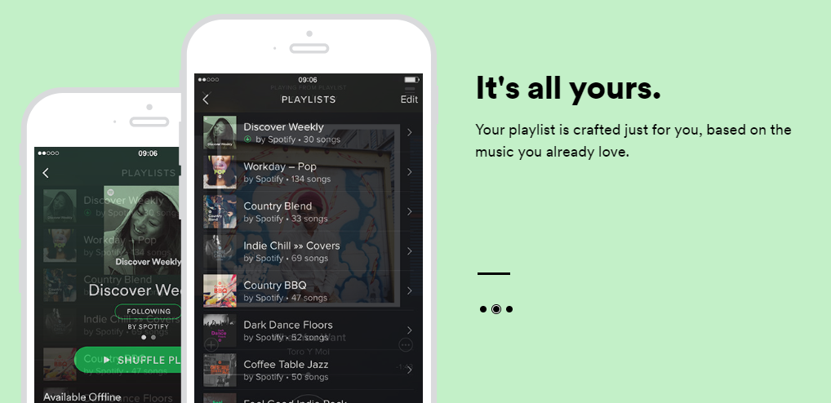
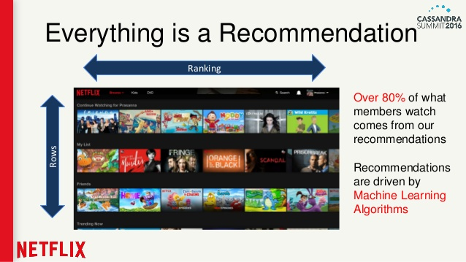
Predictive Models

Slide 10
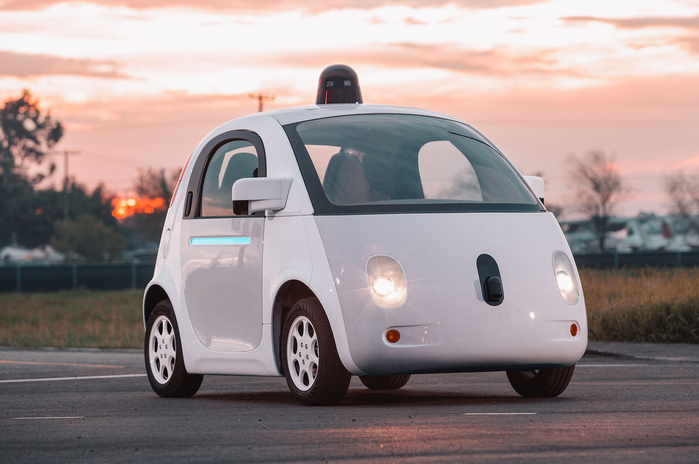
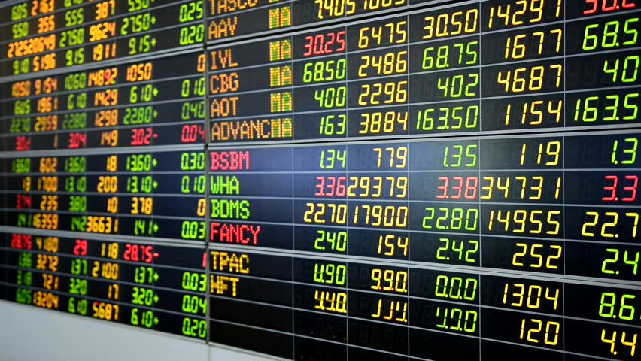
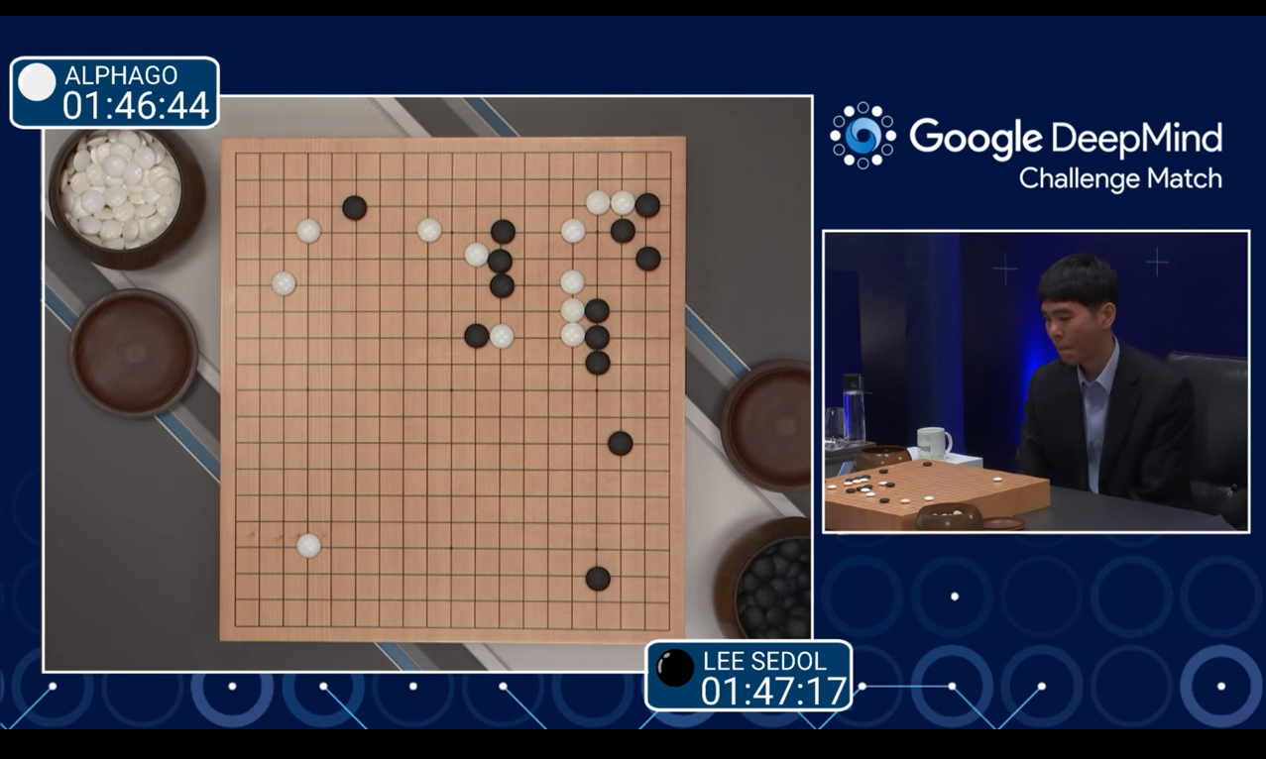
Decision Making

Slide 11

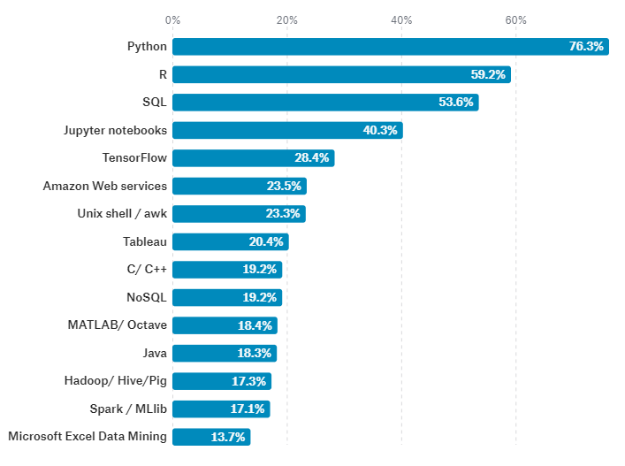
What tools do Data Scientists use?
[from Kaggle’s 2017 Survey on Data Science]
Notes:
Python – Swiss Army Knight; R – popular w/ statisticians
Jupyter – sharing interactive documents; like an online IDE

Slide 12
What math do Data Scientists use?
Calculus and Optimization
Derivatives, Maxima and Minima, Gradient Descent
Statistics
Hypothesis Testing, Significance, Correlation
Linear Algebra
Eigenvector Decomposition, Principle Components Analysis
Machine Learning (applied Calc/Stats/LinAlg)
Regression, Classification, Clustering
Notes:
LinAlg – reducing high dimensional spaces

Slide 13
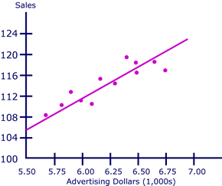
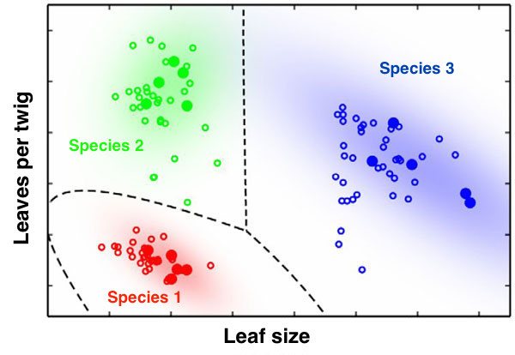
Terminology
Statistics: Samples are composed of Observations that have Variables
Data Science: Datasets are composed of Individuals who have Features
Regression – identifying correlations between features
Predictive Models, A/B Testing
Classification – classifying observations based on their features
Customer Segmentation, Facial Recognition
Notes:
How many ppl here have taken a Statistics course?
Almost all predictive models use regression techniques (some vars you know, some you don’t)
A/B Testing – Spotify shows users two versions of their site – A and B – and measures which one leads to better user retention
Classification – premade classifications

Slide 14
How is Data Science different from Big Data?
“The key word in ‘Data Science’ is not Data, it is Science” – Jeff Leak
Data Science applied statistics
What is it? Answering questions and making decisions using math and data
Big Data engineering at scale
What is it? Scaling computer systems to handle massive storage + computation
Classes: Operating Systems, Databases, Distributed Computing, Big Data
Classes: Statistics, Calculus, Machine Learning, Artificial Intelligence
Notes:
Might be confusing b/c both have “data” – but one is science and one is engineering

Slide 15
Resources for Data Science
Coursera
Data Science Specialization (Roger Peng)
Machine Learning (Andrew Ng)
Books
“Discovering Statistics using R” by Andy Field
“Data Science from Scratch” by Joel Grus
Datasets
Kaggle

Slide 16
Downloads
RStudio
https://www.rstudio.com/
Slides, Data, and Code

Slide 17
Questions?

